Slide 1
Evidence for a Change to Aerosol Fractions: In a Gobi Town

Slide 2
1 Introduction
….fkfdfj

Slide 3
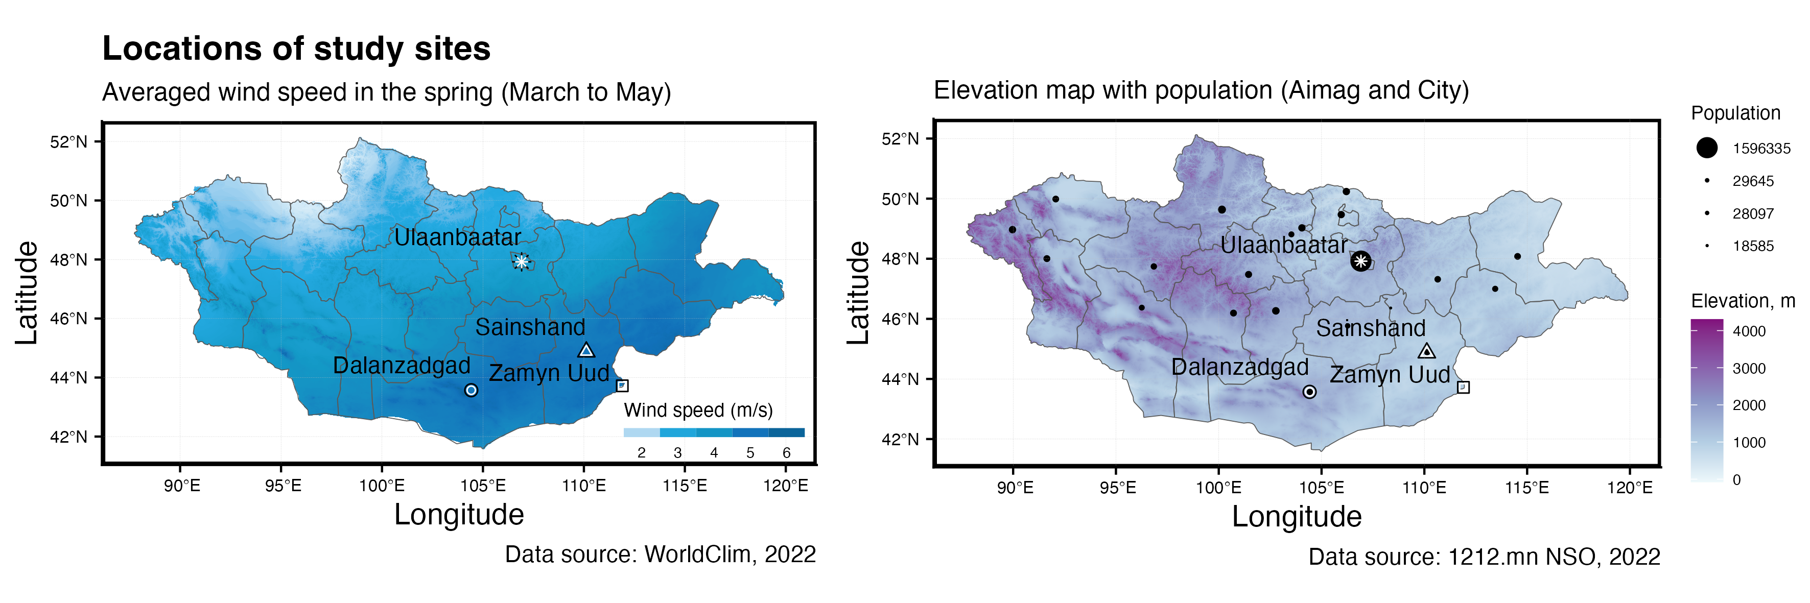
2 Study sites and data
2.1 Study sites
UB (urban, in capital city, at center)
DZ (gobi, inside town, at center)
SS (gobi, outside town, at edge)
ZU (gobi, inside village, at center)
Geographic locations of study sites

Slide 4
]

Slide 5
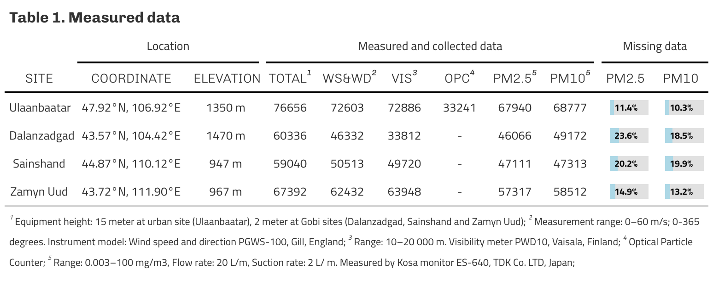
2.2 Data
Table 1. A description of datasets obtained at the sites

Slide 6
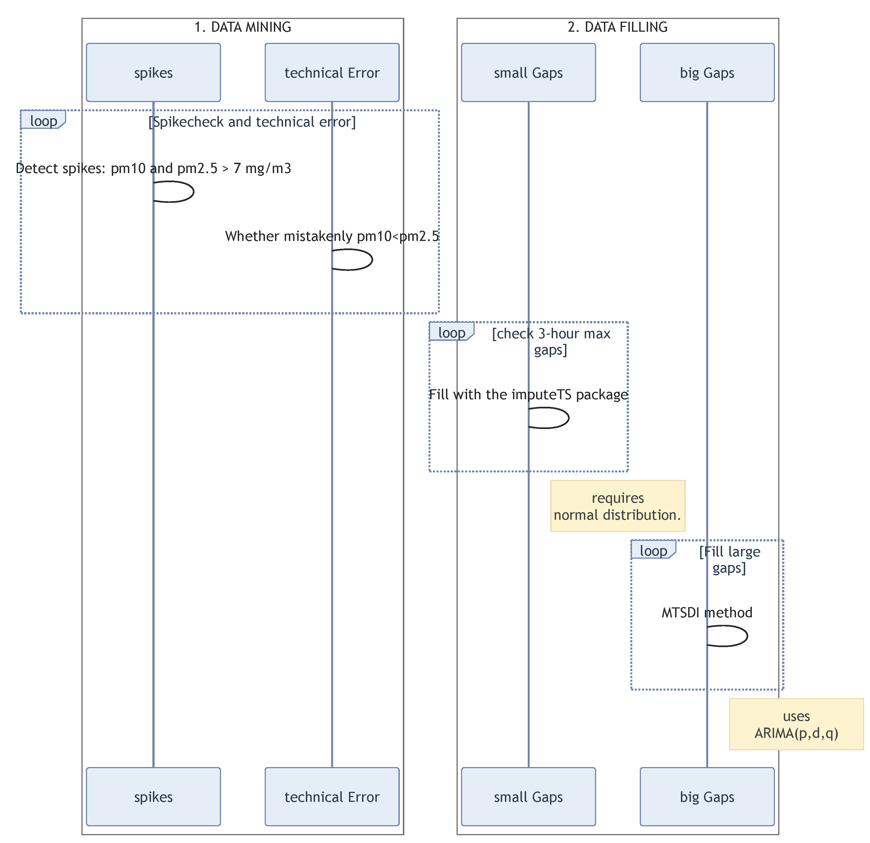
2.3 Data cleaning
Scheme 1. Data handling procedure

Slide 7
2.4 Data filling

Slide 8
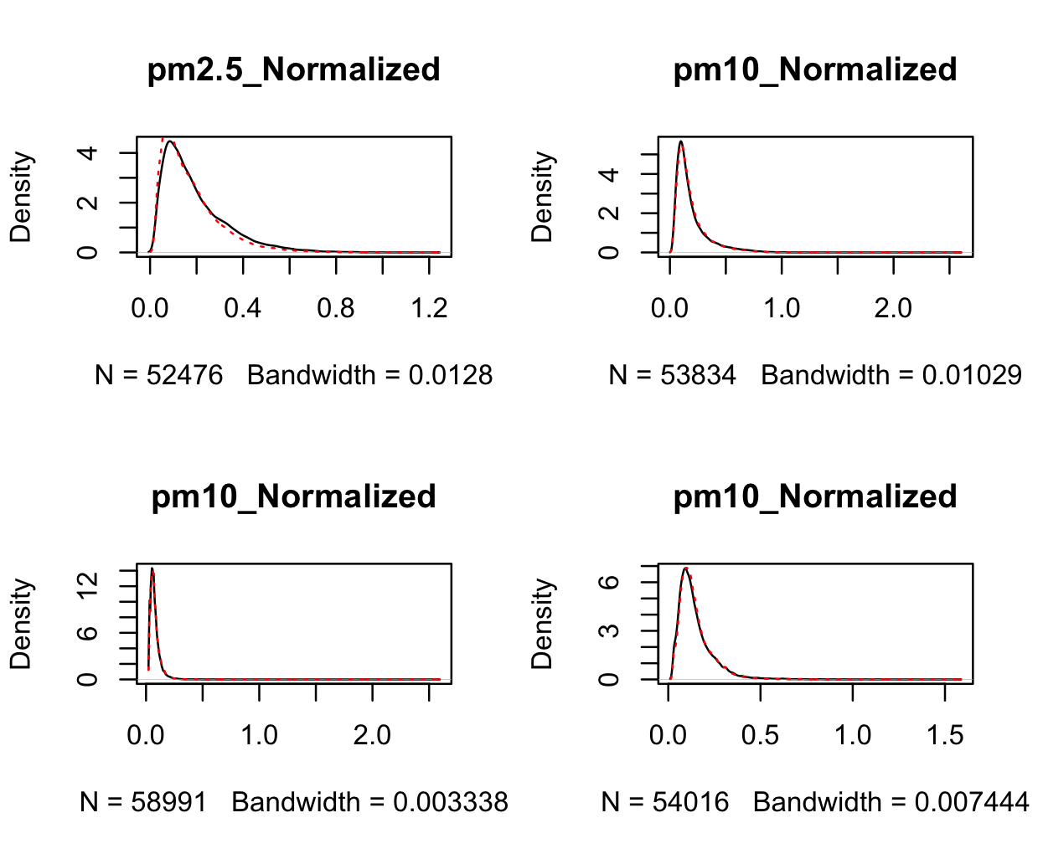
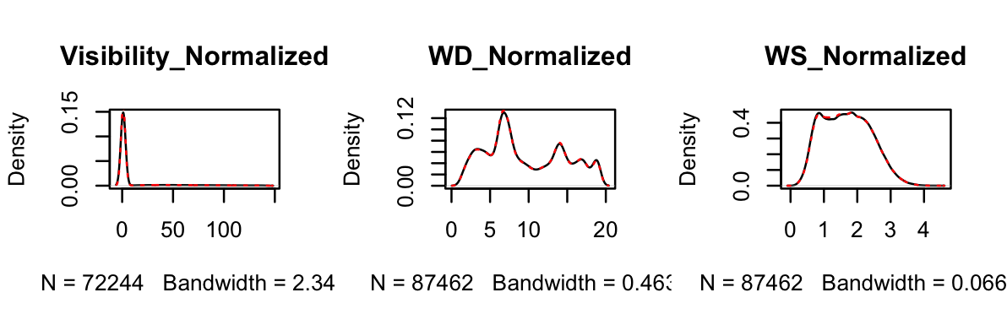
Figure 2. Data gap filling
Figure 2b. Data gap filling

Slide 9
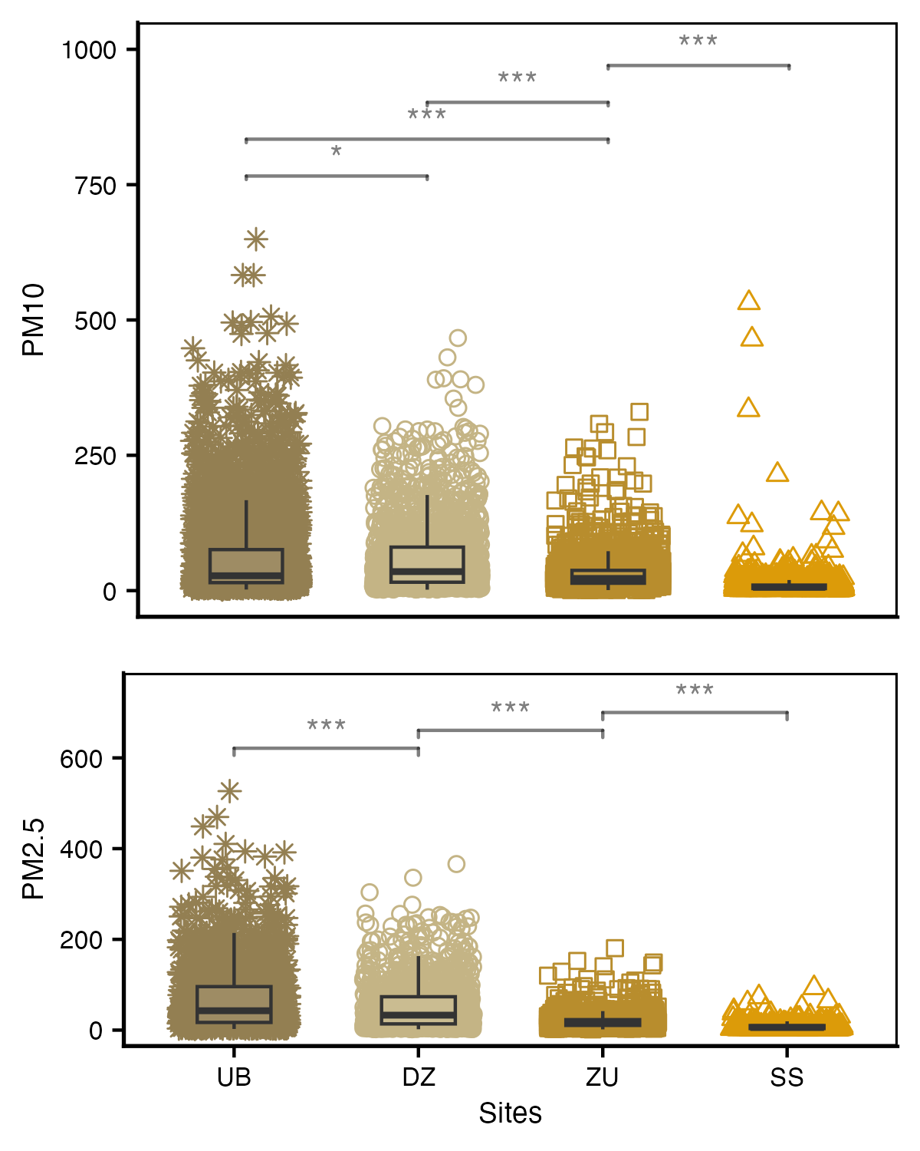
3 Results
3.1 Comparisons
Distinct concentrations of coarse and fine particulates among sites

Slide 10
3.2 Temporal variations

Slide 11
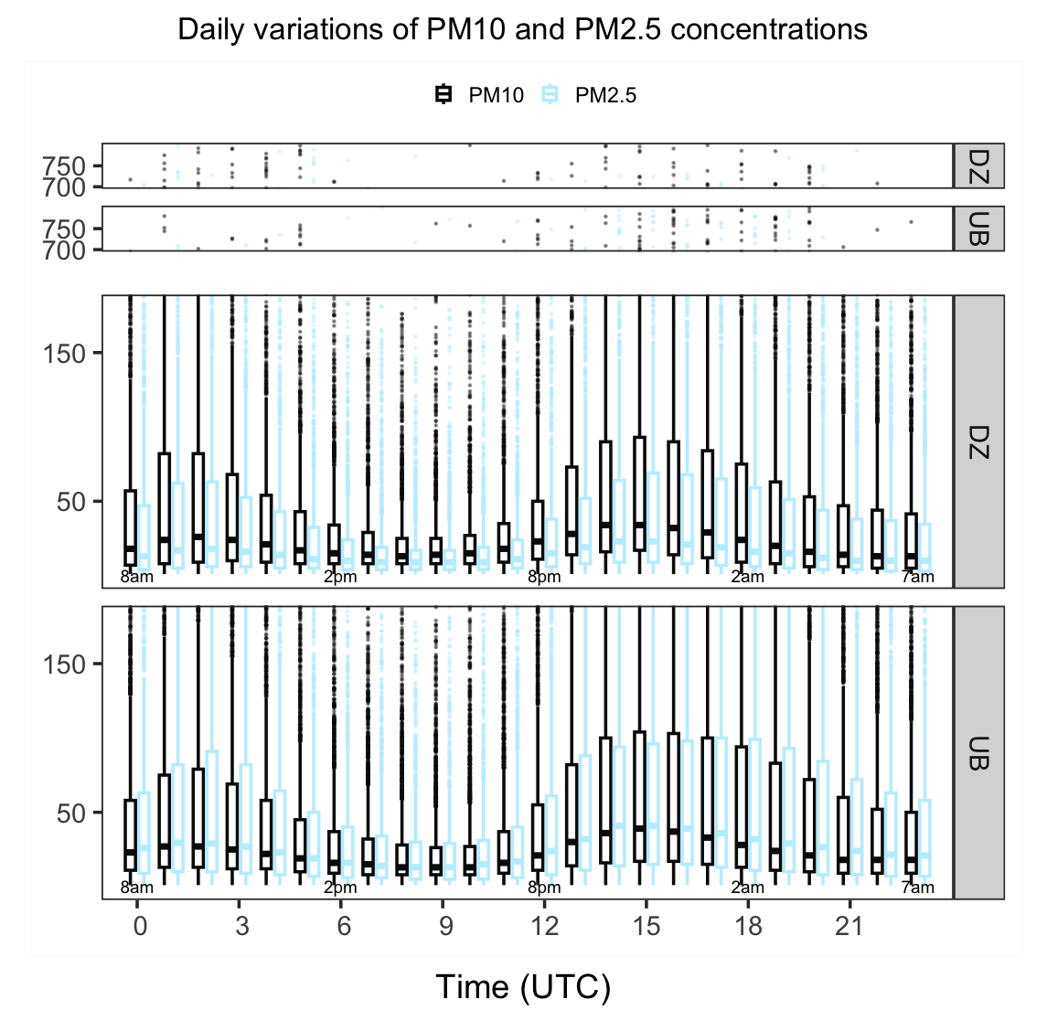
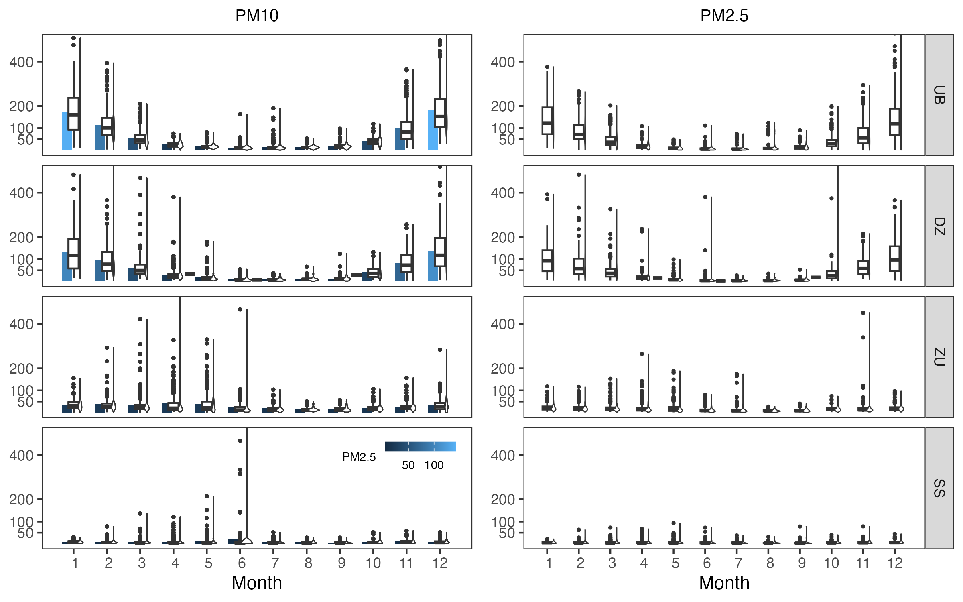
Annual variations of PM10 and PM2.5
Daily variations of PM10 and PM2.5 at UB and DZ sites

Slide 12
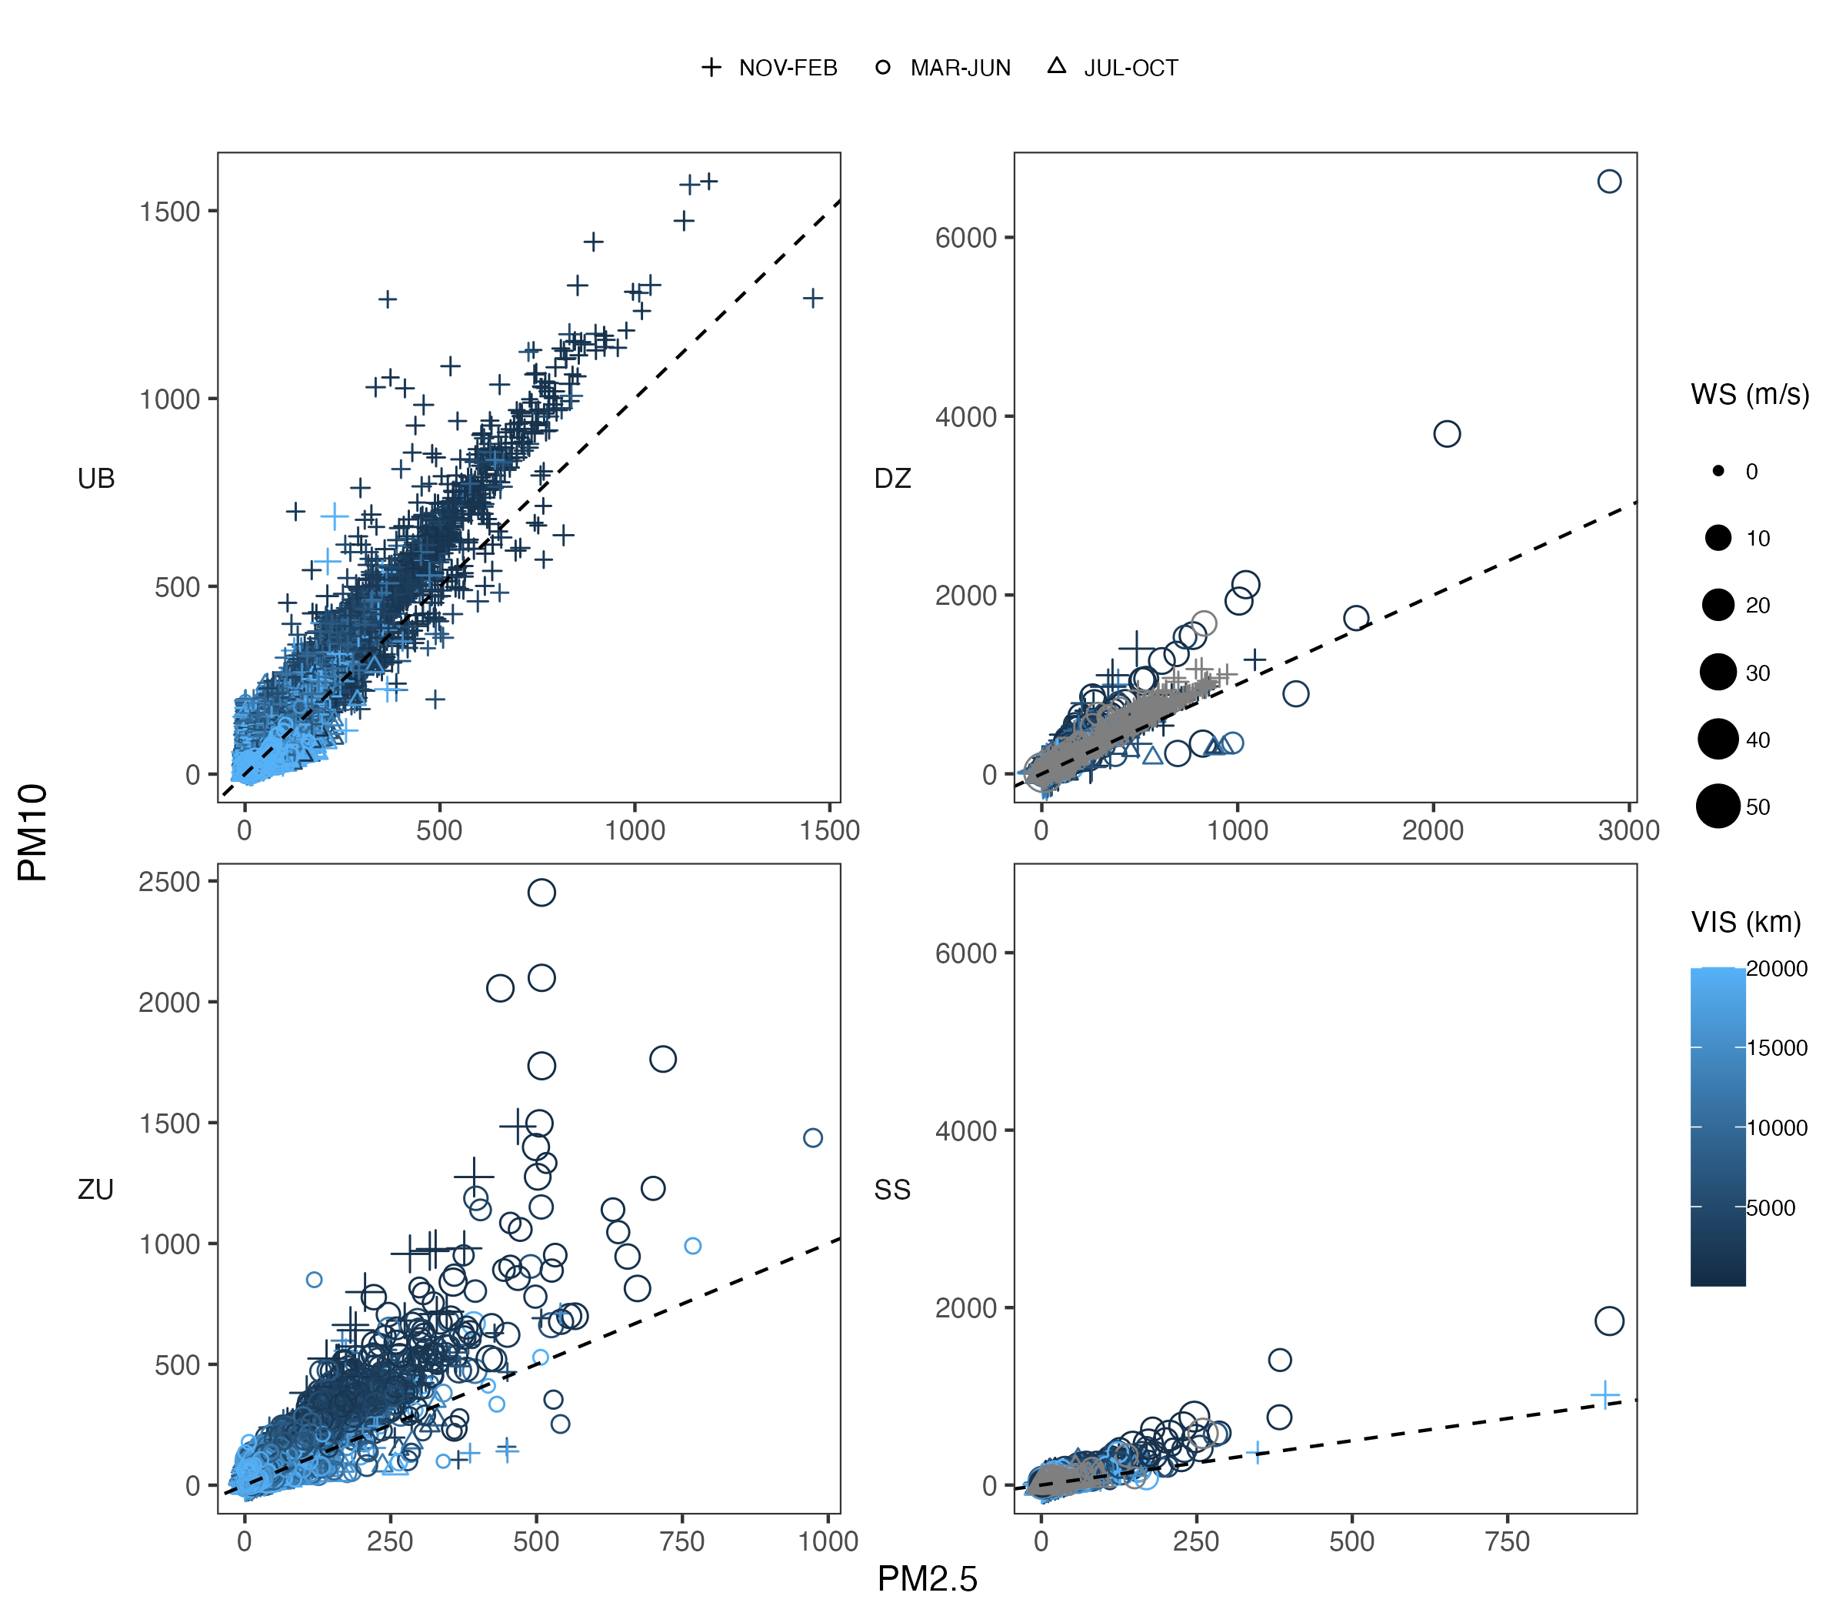
3.3 Meteorological influence on PM10 and PM2.5 variations
Relationships between meteorological major factors and variations of PM10 and PM2.5

Slide 13
3.4 Spatio-temporal distinct feature

Slide 14
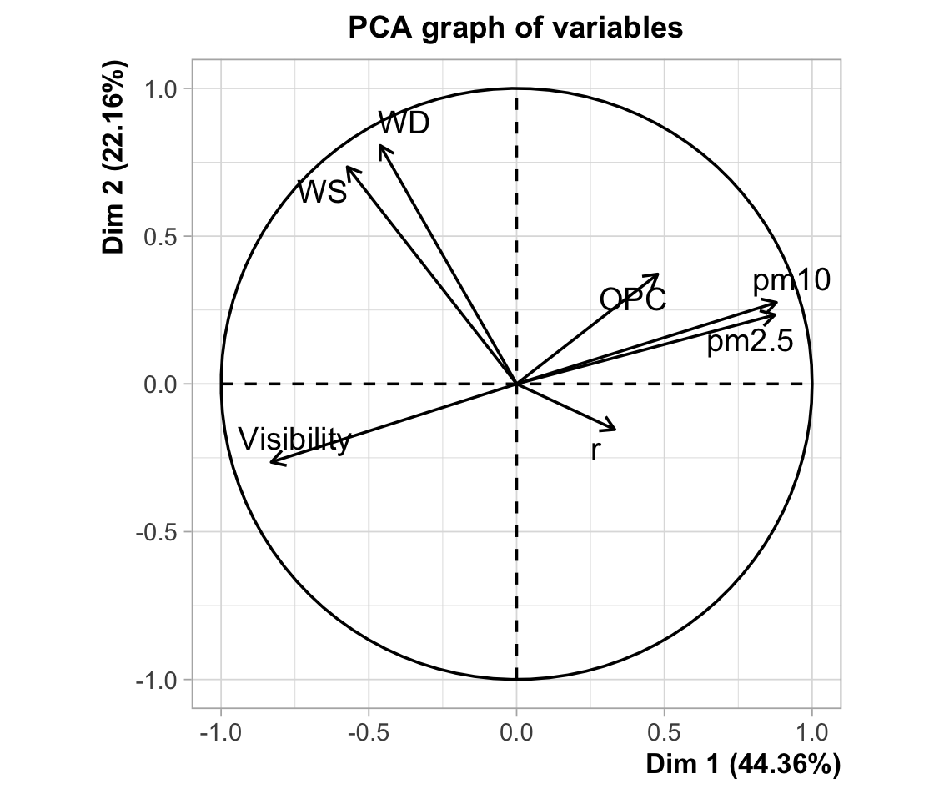
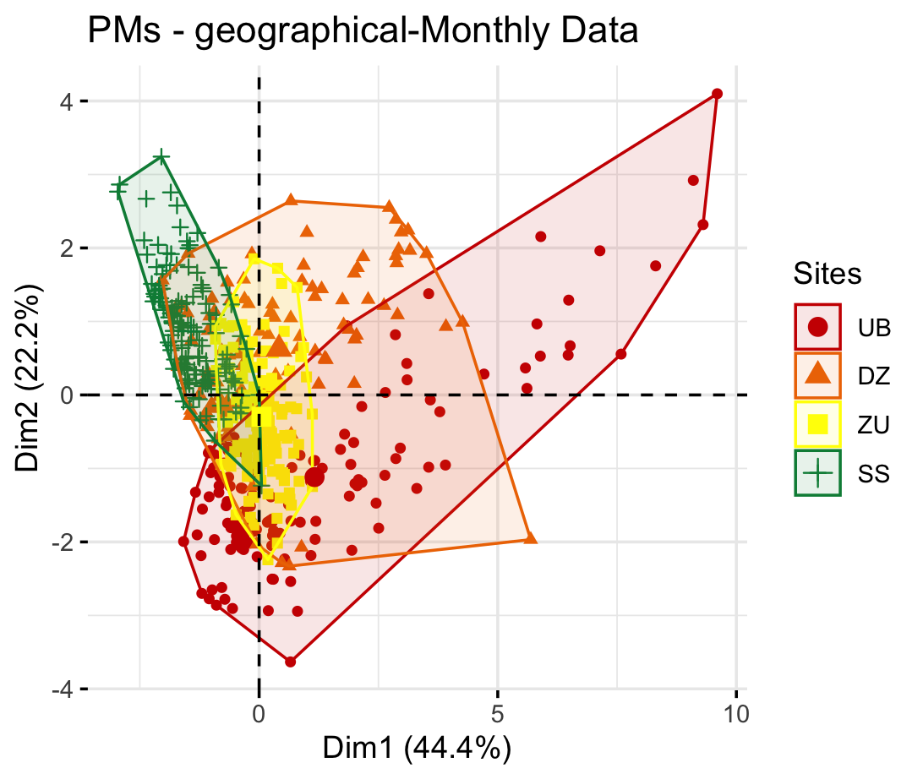
Spatio-temporal distinct feature of variations of PM10 and PM2.5 with PCA analysis
Patterns of meteorology and PMs at the 4 sites

Slide 15
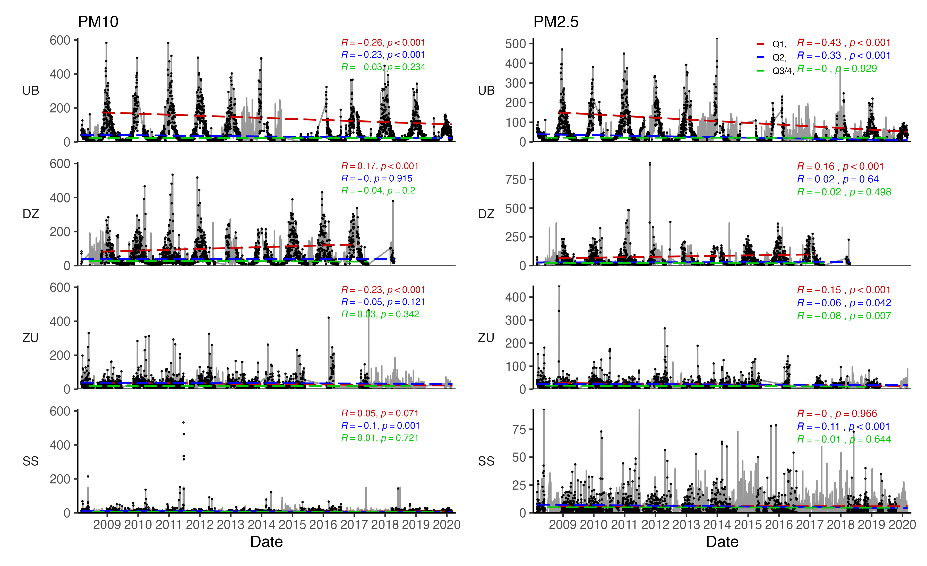
3.5 Trends
Interannual and seasonal trends of PM10 and PM2.5 variations

Slide 16
4 Conclusions

